Slide 1
To forecast whether the client will uphold their booking or terminate it
Done By:
Harish (2022ppd5236@mnit.ac.in)

Slide 2
Abstract
Predetermining the costumer behaviour through the data of the previous booking and with the help of their background, purchasing power and arrival timing of their booking.
Conducting a thorough analysis of each factor can lead to various conclusions that can aid in decreasing room management costs and accurately determining room availability. This, in turn, enables the timely booking of rooms by other customers.

Slide 3
Introduction
Output
Categorical Variable
Booking Status
Input
Categorical Variables
Type of meal planned
Required car parking space
Room type reserved
Market segment type
Repeated Guest
Arrival month & year
Numeric Variables
No of adults & children.
No of weekend & week nights
Room type reserved
No of previous cancellations & confirmations.
Average price per room
No of special requests

Slide 4
Pre-Processing
Filling out the missing values
-There was no missing value.
Data Visualization
-By examining the plots, it becomes evident that the probability of customer confirmation is higher during the months of October, November, and December
Outlier Removal
-Science most of the columns are categorical variables except leading time and average price, we don’t need to be concerned about other columns.

Slide 5
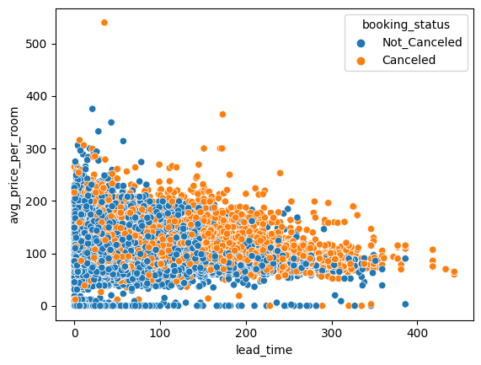
We can see that in leading time there is no outlier but for average price we removed outlier manually by applying condition such that remove all the entries above 400RS price.
df = df[df['avg_price_per_room'] <= 400]

Slide 6
5 Encoding
Encoding is the process of converting data from one representation to another in a machine-readable format.
We utilized Label Encoding to encode the categorical features in our dataset.

Slide 7
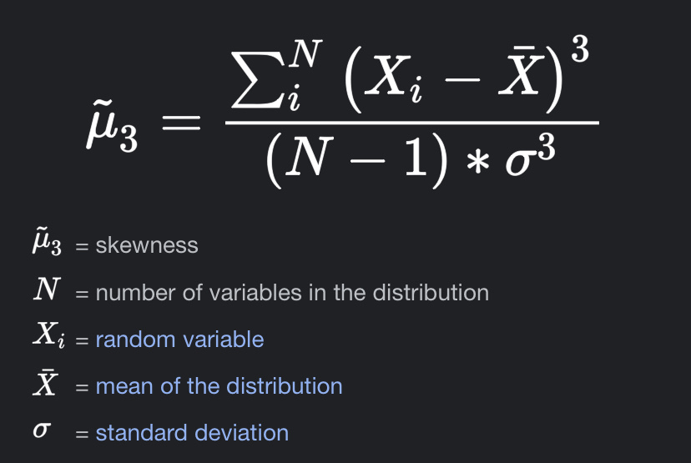
5. Data Interpterion
The behavior of data can be studied using diverse methods. Mean, RMS, skewness, and kurtosis are some of the techniques employed. These approaches provide insights into different aspects of data behavior. In dataset we found the skewness for each column:
no_of_adults: -0.33
no_of_children: 3.94
no_of_weekend_nights: 0.74
no_of_week_nights: 1.60
required_car_parking_space: 5.41
room_type_reserved: 3.09
lead_time: 1.29
market_segment_type: 1.24
repeated_guest: 6.00
no_of_previous_cancellations: 25.19
no_of_previous_bookings_not_canceled: 19.2

Slide 8
6. Scaling the data
scaling refers to the process of transforming the numerical values of features in a dataset to fall within a specific range or scale. This is often done to ensure that all features have a similar magnitude and do not disproportionately influence the learning algorithm during machine learning or statistical analysis.
We used Min-Max scaler for data encoding
X_scaled = (X - X_min) / (X_max - X_min)

Slide 9
6. Correlation Matrix
Correlation matrix is a matrix that shows the correlation coefficients between pairs of variables in a dataset. Correlation is a statistical measure that quantifies the strength and direction of association between two variables.
Correlation coefficient is a value between -1 and 1, where -1 indicates a perfect negative correlation (as one variable increases, the other decreases), 1 indicates a perfect positive correlation (as one variable increases, the other also increases), and 0 indicates no correlation (the variables are unrelated).

Slide 10
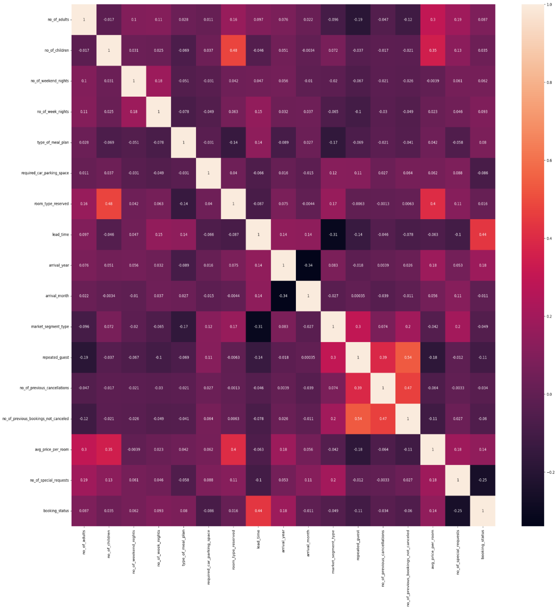

Slide 11
Methodology
We employed various approaches to analyze the dataset with increased accuracy, while also taking into consideration the training and testing time.
The dataset was not compatible with the regression-based approach, as the maximum accuracy achieved was only around 64% using Random Forest Regressor, and the processing time took approximately 10.12 seconds.

Slide 12
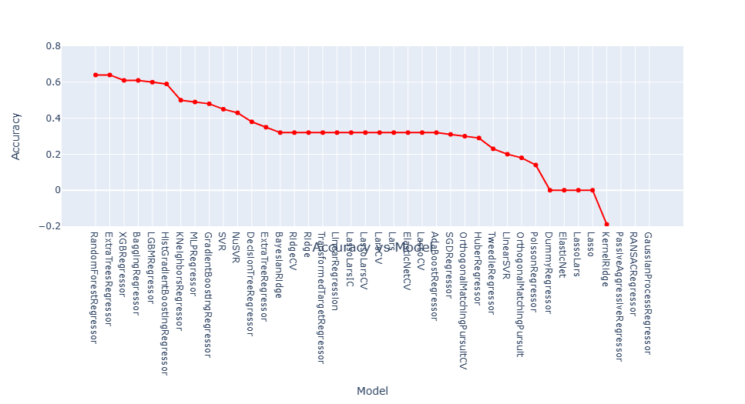

Slide 13
We utilized a classification-based approach to evaluate the accuracy performance of the dataset, employing various classification techniques.
Model | Accuracy | Balanced Accuracy | ROC AUC | F1 Score | Time Taken
Random Forest Classifier | 0.9 | 0.87 | 0.87 | 0.89 | 3.82
Extra Trees Classifier | 0.89 | 0.86 | 0.86 | 0.89 | 2.76
XGB Classifier | 0.89 | 0.86 | 0.86 | 0.89 | 2.52
Bagging Classifier | 0.88 | 0.86 | 0.86 | 0.88 | 0.66
LGBM Classifier | 0.88 | 0.86 | 0.86 | 0.88 | 0.67
Decision Tree Classifier | 0.86 | 0.85 | 0.85 | 0.86 | 0.2
Label Spreading | 0.85 | 0.83 | 0.83 | 0.85 | 551.45
Label Propagation | 0.85 | 0.83 | 0.83 | 0.85 | 270.02
K Neighbours Classifier | 0.85 | 0.83 | 0.83 | 0.85 | 10.71
Extra Tree Classifier | 0.85 | 0.82 | 0.82 | 0.84 | 0.08
SVC | 0.84 | 0.79 | 0.79 | 0.83 | 53.82
Ada Boost Classifier | 0.82 | 0.78 | 0.78 | 0.81 | 1.01

Slide 14
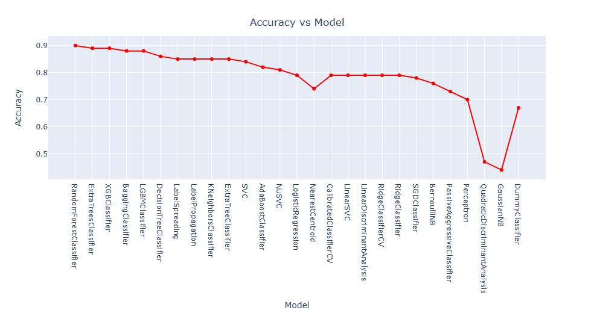

Slide 15
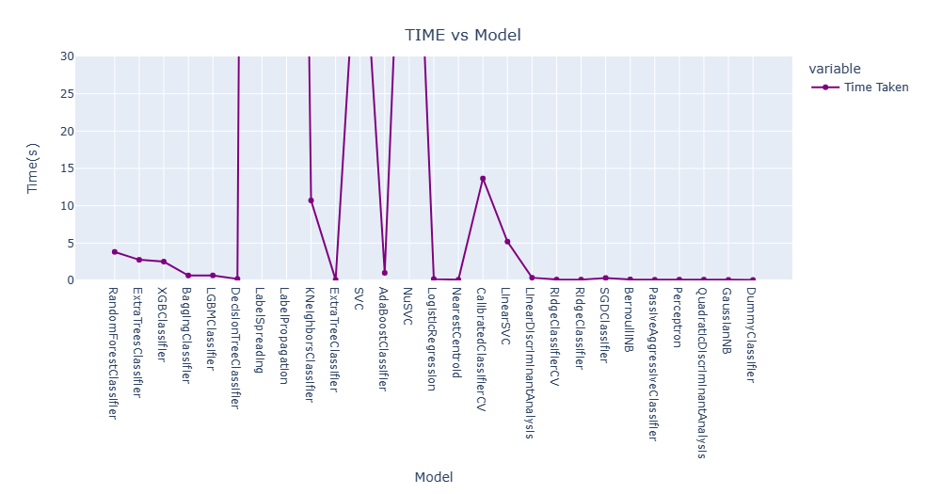

Slide 16
Results & Discussion:
the Decision Tree Classifier and Extra Tree Classifier models took the least amount of time (about 0.04 seconds) and achieved an accuracy of around 85%. On the other hand, by using the Random Forest classification approach, we were able to achieve an accuracy of 90%, but it took around 2.35 seconds to complete.
 | precision | recall | f1-score | support
0.0 | 0.90 | 0.90 | 0.90 | 8024
1.0 | 0.79 | 0.79 | 0.79 | 3940
accuracy |  |  | 0.86 | 11964
macro avg | 0.84 | 0.84 | 0.84 | 11964
weighted avg | 0.86 | 0.86 | 0.86 | 11964

Slide 17
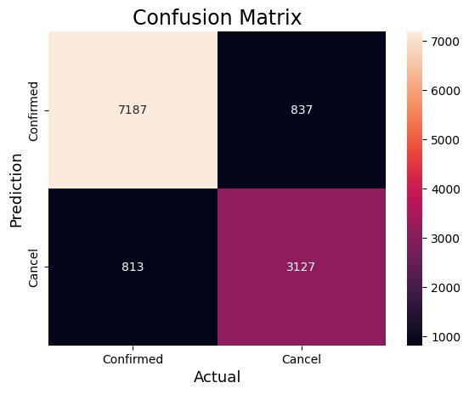

Slide 18
References
Introduction to Machine Learning with Python by Andreas C. Müller, Sarah Guido

